Slide 1
Asymptotic Notations

Slide 2
Mathematical Model of Computation
Framework for Algorithmic Analysis
Need of Mathematical Model
Real Computers Vs Mathematical Model

Slide 3
Mathematical Model of Computation
Model of Computation specifies:
What operations in an algorithm is allowed
Cost (time) of each operation
Two components of Model
Processor (has defined instruction set)
Memory (collection of locations)
Notes:
Identify the Model of Computation
Choose the abstract machine or framework you are using to measure execution:
Turing Machine: Count the total number of state transitions (movements and writes on the tape) before halting.
Random Access Machine (RAM): Count the number of basic machine-level instructions executed (assignments, comparisons, basic arithmetic).
Boolean Circuit: Count the number of logic gates (AND, OR, NOT) or circuit depth.

Slide 4
Computing running time in Model
Simple Statement
(1 step execution )
Arithmetic & logical operations.
Jumps & conditional jumps
Pointer instruction
Array operations (1D) [2 step execution]
Notes:
How multiplication is treated shifts across the major variants of the RAM model:
1. The Standard (Unit-Cost) RAM Model
In the most commonly used version of the RAM model for basic algorithm analysis, multiplication is supported as a primitive instruction and is assigned a uniform cost of \(O(1)\) (constant time). [1, 2]
The Assumption: It assumes that the CPU can multiply any two numbers stored in its registers in a single step, regardless of how large those numbers are. [1]
Why it's used: It simplifies the mathematical analysis of algorithms (like sorting or matrix multiplication) by treating basic math as an atomic operation. [1, 2]
2. The Word RAM Model
In a more realistic version called the Word RAM model, data is stored in "machine words" of a fixed size, usually capped at \(w\) bits (where \(w \ge \log n\), and \(n\) is the input size). [1, 2]
The Assumption: You can directly multiply two integers in \(O(1)\) constant time only if both numbers fit cleanly inside a single machine word.
Large Numbers: If you need to multiply numbers that span multiple words (arbitrary-precision integers), you cannot use a direct constant-time operation. You must instead implement an explicit multiplication algorithm (like Karatsuba or Schönhage–Strassen), which will have a higher non-constant cost. [1]
3. The Logarithmic-Cost RAM Model
If you are doing strict complexity theory where arbitrary-precision arithmetic matters, the standard unit-cost model becomes unrealistic because it would theoretically allow you to multiply infinitely large numbers in one step. The Logarithmic-Cost RAM model fixes this

Slide 5
More Complex Statement
(multistep execution)
A=B+C*D-F 3 steps
A[I]=B[I] + C[I] 4 steps
C = A[I,J] 4 steps
A’ [(I)*M + J] where m is the number of columns
X=B[I]
Y=C[I]
Z=X+Y
A[I]=Z
Notes:
2D array evaluation: Needs 1 multiplication + 2 additions + 1 fetch = 4 total steps
1D = base address x size of elements
2D = base address + ( i x no. of col + j) x size of elements [total 4 operators]
The Pattern
As you scale up the dimensions of an array, a clean mathematical pattern emerges for the absolute step cost:
1D Array: 1 operation 2D Array: 4 operations 3D Array: 6 operations N-Dimensional Array: \(2N\) operations
(For an \(N\)-dimensional array, it generally takes \(N-1\) multiplications, \(N-1\) additions to accumulate offsets, 1 final base address addition, and 1 memory fetch, summing to precisely \(2N\) steps).

Slide 6
General Analysis Strategy T(n)
T(n)= n
Max time taken by an algorithm to solve any instance of size n.
measures a goodness of an algorithm, i.e functional form of T(n) is important (linear, cubic, quadratic, etc.)
Significance of T(n) is independent of model/computer we used for analysis because here the objective is to characterize the algorithm not the machine
Running Time Calculations
To Add elements of two arrays of size n

Slide 7
Asymptotic Notations
Has two features
Function classification
Identify the behaviour as n→ ∞

Slide 8
Asymptotic Complexity
Running time of an algorithm as a function of input size n for large n.
Expressed using only the highest-order term in the expression for the exact running time.
  Instead of exact running time, say Θ(n²).
Written using Asymptotic Notation.

Slide 9
Asymptotic Notation
Θ, O, Ω, o, ω
Defined for functions over the natural numbers.
  Ex: f(n) = Θ(n²).
  Describes how f(n) grows in comparison to n².
The notations describe different rate-of-growth relations between the defining function and the defined set of functions.

Slide 10
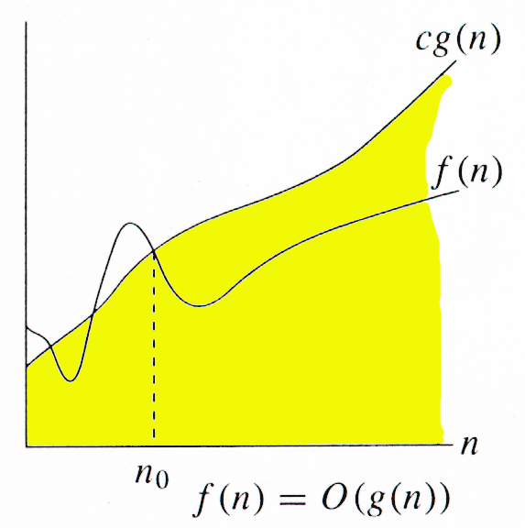
O-notation
For function g(n), we define O(g(n)), big-O of n, as the set:
O(g(n)) = {f(n) :
∃ positive constants c and n_{0,} such that ∀n ≥ n₀,
we have 0 ≤ f(n) ≤ cg(n) }
Intuitively: Set of all functions whose rate of growth is the same as or lower than that of g(n).
g(n) is an asymptotic upper bound for f(n).
f(n) = Θ(g(n)) ⇒ f(n) = O(g(n)).
Θ(g(n)) ⊂ O(g(n)).

Slide 11
Examples
O(g(n)) = {f(n) : ∃ positive constants c and n₀, such that ∀n ≥ n₀, we have 0 ≤ f(n) ≤ cg(n) }
Any linear function an + b is in O(n²). How?
Show that 3n³=O(n⁴) for appropriate c and n₀.
Notes:
in big oh calculation, we have multiple combination of n and c value possible
Mathematically, both combinations are equally correct because Big-Oh notation only requires that some valid pair of (c) and (n) exists.
a smaller (c) with a reasonable (n) is generally preferred in analysis.
Smaller (c): Gives a tighter, more accurate upper bound on how fast your algorithm grows.
A huge (c) (like (c = 1,000,000)) technically works, but it makes the upper bound very loose and less useful in practice.
In Big-Omega notation, the preference flips: a larger (c) is generally preferred over a smaller
Big-Omega represents a lower bound,, meaning your algorithm will run at least this fast.
Here is why a larger (c) is preferred:
Tighter Lower Bound: A larger (c) pushes the lower bound higher, making it a tighter and more realistic estimate of the minimum work the algorithm must do

Slide 12
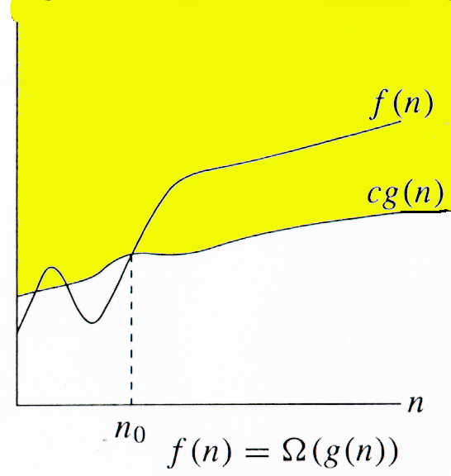
Ω -notation
For function g(n), we define Ω(g(n)), big-Omega of n, as the set:
Ω(g(n)) = {f(n) :
∃ positive constants c and n_{0,} such that ∀n ≥ n₀,
we have 0 ≤ cg(n) ≤ f(n)}
Intuitively: Set of all functions whose rate of growth is the same as or higher than that of g(n).
g(n) is an asymptotic lower bound for f(n).
f(n) = Θ(g(n)) ⇒ f(n) = Ω(g(n)).
Θ(g(n)) ⊂ Ω(g(n)).
Notes:
What Happens to the Negative Sign in Asymptotic Notation ((O, Omega, Theta))?
When you convert that exact function into Big-Oh, Big-Omega, or Big-Theta, the negative terms are dropped because we only care about the fastest-growing term as (n) goes to infinity.
For Big-Oh — Upper Bound
To find a larger upper bound, you can safely drop the negative term entirely.
If (f(n) = 5n^2 - 2n
Since (-2n <= 0), it is always true that (5n^2 - 2n <= 5n^2).
Therefore, you can easily choose (c = 5) to prove it is (O(n^2)).
For Big-Omega — Lower Bound
To find a smaller lower bound, you cannot just drop the negative term, because dropping it would make your estimate larger, not smaller. Instead, you "pay" for the negative term using a fraction of your dominant term.
If (f(n) = 5n^2 - 2n)
For large values of (n) (specifically\(n >= 2)), the (2n) term is much smaller than (n^{2}). You can rewrite the function to guarantee a lower floor: (5n^2 - 2n>= 5n^2 - 2n^2 = 3n^2).
Therefore, you choose (c = 3) to prove it is (Omega(n^2))

Slide 13
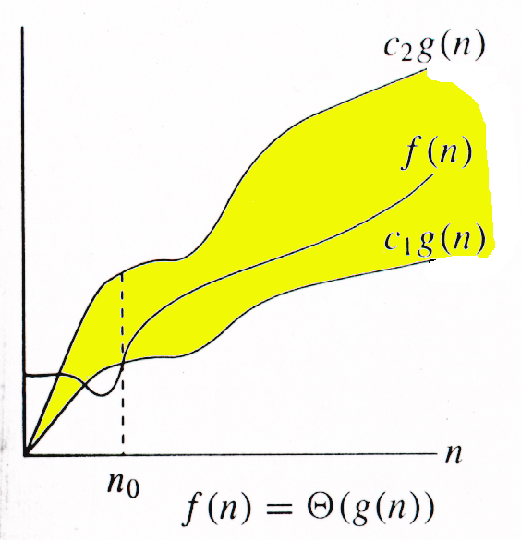
Θ-notation
For function g(n), we define Θ(g(n)), big-Theta of n, as the set:
Θ(g(n)) = {f(n) :
∃ positive constants c₁, c₂, and n_{0,} such that ∀n ≥ n₀,
we have 0 ≤ c₁g(n) ≤ f(n) ≤ c₂g(n)
}
Intuitively: Set of all functions that
have the same rate of growth as g(n).
g(n) is an asymptotically tight bound for f(n).

Slide 14
Θ-notation
For function g(n), we define Θ(g(n)), big-Theta of n, as the set:
Θ(g(n)) = {f(n) :
∃ positive constants c₁, c₂, and n_{0,} such that ∀n ≥ n₀,
we have 0 ≤ c₁g(n) ≤ f(n) ≤ c₂g(n)
}
Technically, f(n) ∈ Θ(g(n)).
Older usage, f(n) = Θ(g(n)).
accept either notation…
f(n) and g(n) are nonnegative, for large n.

Slide 15
Example
Θ(g(n)) = {f(n) : ∃ positive constants c₁, c₂, and n₀, such that ∀n ≥ n₀, 0 ≤ c₁g(n) ≤ f(n) ≤ c₂g(n)}
10n² - 3n = Θ(n²)
What constants for n₀, c₁, and c₂ will work?
Make c₁ a little smaller than the leading coefficient, and c₂ a little bigger.
To compare orders of growth, look at the leading term.

Slide 16
Relations Between Θ, O, Ω

Slide 17
Relations Between Θ, Ω, O
Theorem : For any two functions g(n) and f(n),
f(n) = Θ(g(n)) iff
f(n) = O(g(n)) and f(n) = Ω(g(n)).
I.e., Θ(g(n)) = O(g(n)) ∩ Ω(g(n))
In practice, asymptotically tight bounds are obtained from asymptotic upper and lower bounds.

Slide 18
Running Times
“Running time is O(f(n))” ⇒ Worst case is O(f(n))
“Running time is Ω(f(n))” ⇒ Best case is Ω(f(n))

Slide 19
Comparison of Functions
f ↔ g ≈ a ↔ b
f (n) = O(g(n)) ≈ a ≤ b
f (n) = Ω(g(n)) ≈ a ≥ b
f (n) = Θ(g(n)) ≈ a = b
f (n) = o(g(n)) ≈ a < b
f (n) = ω (g(n)) ≈ a > b

Slide 20
Properties
Transitivity
f(n) = Θ(g(n)) & g(n) = Θ(h(n)) ⇒ f(n) = Θ(h(n))
f(n) = O(g(n)) & g(n) = O(h(n)) ⇒ f(n) = O(h(n))
f(n) = Ω(g(n)) & g(n) = Ω(h(n)) ⇒ f(n) = Ω(h(n))
f(n) = o (g(n)) & g(n) = o (h(n)) ⇒ f(n) = o (h(n))
f(n) = ω(g(n)) & g(n) = ω(h(n)) ⇒ f(n) = ω(h(n))
Reflexivity
f(n) = Θ(f(n))
f(n) = O(f(n))
f(n) = Ω(f(n))

Slide 21
Properties
Symmetry
f(n) = Θ(g(n)) iff g(n) = Θ(f(n))
Complementarity
f(n) = O(g(n)) iff g(n) = Ω(f(n))
f(n) = o(g(n)) iff g(n) = ω((f(n))

Slide 22
Growth of a function
Find the big oh for the following functions
f(n) = 3n + 5
f(n) = 27n² + 16n + 25
f(n) = 3n³ + 4n
f(n) = 2^{n} + 6n² + 3n
f(n) = 5*2^{n} + 3n +5
f(n) = 3*2^{n} + 4n² + 5n + 3

Slide 23
Incorrect bounds
7n+5 ≠ O(1)
27n² + 16n + 25 ≠ O(n)
5n³ + n² + 3n + 2 ≠ O(n²)

Slide 24
Find the big Omega for the following functions
f(n) = 27n² + 16n
f(n) = 4n³ + 2n + 3
f(n) = 2^{n} + 6n² +3n
f(n) = 5*2^{n} + 3n +5

Slide 25
Incorrect bounds
7n+5 ≠ Ω(n²)
5n² + 4n +2 ≠ Ω(n³)
3n³+ 5n² +2n ≠ Ω(n⁴)

Slide 26
Find the Thetafor the following functions
f(n) = 27n² + 16n
f(n) = 4n³ + 2n + 3
f(n) = 2^{n} + 6n² +3n

Slide 27
Incorrect bounds
7n+5 ≠ Θ (1)
10n²+ 7 ≠ Θ (n³)
5n+8 ≠ Θ (n²)

Slide 28
Related Contents
Basics of Asymptotic Notations
https://cexpertvision.com/2023/06/23/basics-of-asymptotic-notations/

Slide 29
Video Lecture of the topic can be found at
Mathematical Model of Computation
https://youtu.be/JEnXJPlXhng
Basics of Asymptotic Notations
https://youtu.be/OQZySiRblPo

